Slide 1

Factor Investing on DJIA
Gaurav sharma

Slide 2
Executive Summary
A factor can be thought of as any characteristic relating a group of securities that is important in explaining their return and risk. Certain factors have historically earned a long-term risk premium and represent exposure to systematic sources of risk. Factor investing is the investment process that aims to harvest these risk premia through exposure to factors.
In this case study, I have worked on constructing three equity risk premia factors: Value, Low Volatility, and Momentum apart from market factor, using monthly returns data of DJIA. Subsequently, I have used these factors to build investment strategy by choosing a equal weighted long portfolio consists of top 2 ranked stocks (out of 22 given) with greatest combined factor score, i.e. stocks with lowest P/B and EV/S scores, highest momentum scores (past 1 year return), and lowest vols scores (past 1 year standard deviation) with monthly rebalancing.
I have also constructed equal weighted short portfolios using lowest combined factor scores as well as a notional neutral long-short portfolios using above three factors. As an additional exercise, I have also explored different sector based returns (factors) and PCA based factors using value, vol, momentum, and market factors. Further, I have computed the correlations among factors and regressed the long/short/long-short portfolio returns against four factors to estimated the statistical significance and influence of each factor in explaining investment strategy returns. In the conclusion, portfolio stats alongside wealth index are shown for various strategies. Factors constructed using long only portfolios show superior risk adjusted performance primarily driven by momentum factor for the period of study.

Slide 3
Factors Construction
The basic idea for calculation of factor scores is to compute z-scores of P/B, EV/S, momentum, and vol for every ticker at a particular month and repeating this exercise for every month in the dataset.
We winsorize the top/bottom ranked z-scores using a winsorize factor to get rid of outliers.
Momentum for each ticker is calculated as past 12 month return and then momentum z-score is calculated by comparing momentum for each ticker with momentum of all other tickers at a particular month.
Similarly, vol for each tickers is calculated as past 12 months returns standard deviation and then vol z-score is calculated by comparing vol for each ticker with vol for all other tickers at a particular month.
Valuation score is the sum of P/B z-score and EV/S z-score.
Market factor (market premium) is calculated as monthly return of DJIA and subtracting monthly risk free rate.
Total score is calculated as sum of momentum z-score, (-valuation z-score), and (-vol z-score) to capture high momentum, low valuation, and low vol stocks.

Slide 4
Factors returns
Once we have z-scores for each factor, we can easily calculate factor returns. We introduce one month lag for each factor return calculation to observe the performance of a portfolio with most desired z-scores. For example, we need to observe the performance of two stocks with highest momentum z-scores at a particular month in the next month for a long only portfolio in order to determine the performance of investment strategy.
For factor returns using long only portfolios, we calculate the equally weighted portfolio return each month, composed of top 2 ranked stocks (top decile) with highest z-scores for momentum, lowest z-scores for vol, lowest z-scores for value, and highest z-scores for total long only portfolio strategy,
For factor returns using short only portfolios, we calculate the equally weighted portfolio return each month, composed of top 2 ranked stocks (bottom decile) with lowest z-scores for momentum, highest z-scores for vol, highest z-scores for value, and lowest z-scores for total short only portfolio strategy,
For factor returns using long-short portfolios, we calculate the equally weighted portfolio return each month, composed of top 2 ranked stocks with highest total z-scores for long only portfolio strategy and lowest total z-scores for short only portfolio strategy and adding both long only and short only returns to compute long-short portfolio strategy returns. We are assuming the notional neutral long-short portfolio to calculate long-short returns.

Slide 5
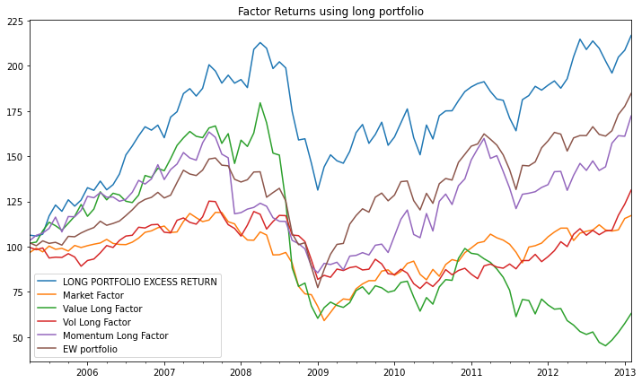
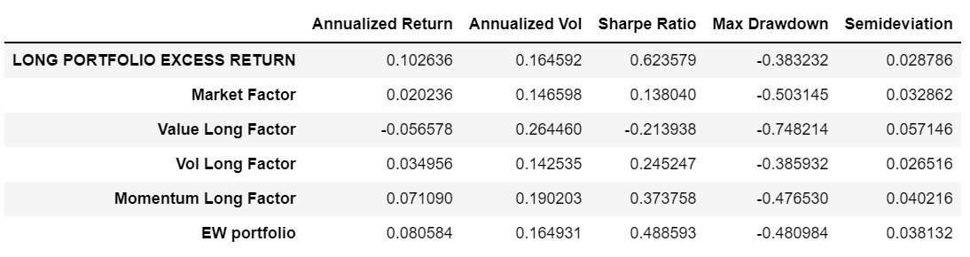
Factors/long strategy performance
As we can see in the chart/table at the right hand slide, long only investment strategy using highest combined factor scores has outperformed broader market and equal weighted portfolio with higher annualized return (10.26%) and higher Sharpe ratio (0.623).
The outperformance of long only strategy was primarily driven by outperformance of momentum and vol factors. Value factor has significantly underperformed its peers as well as broader market during this period.

Slide 6
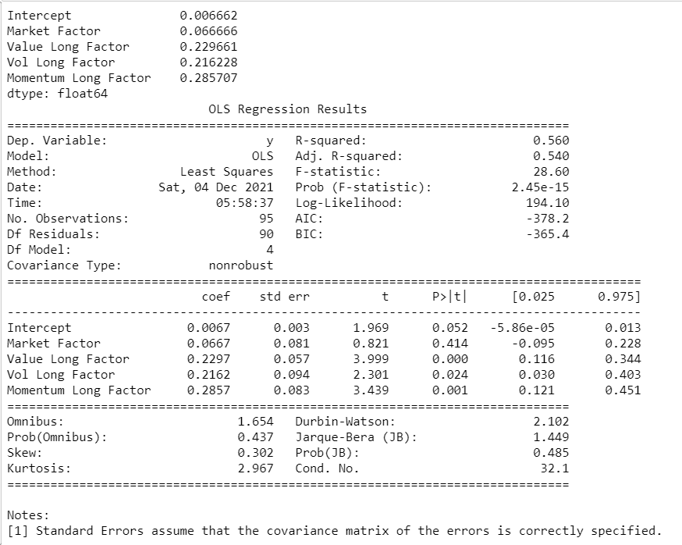
Long strategy factor exposures
We use the OLS regression to compute the long only investment strategy’s exposure on various factors. We have regressed long-only strategy returns with market risk premium, value, vol, and momentum factors calculated using long portfolio to determine the primary factors driving the strategy returns.
As shown in the table located at the right hand side, long only strategy is primarily driven by momentum factor with a slope coefficient of 0.2857 and t-stat of 3.439, followed by value factor with slope coefficient of 0.2297 and t-stat of 3.999.

Slide 7
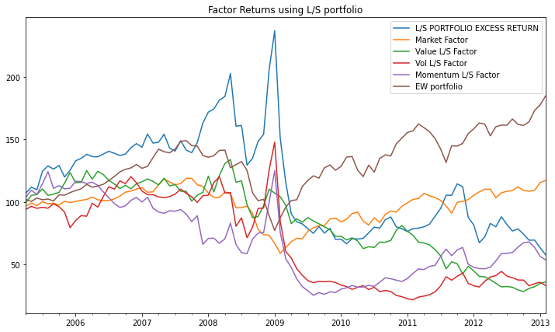
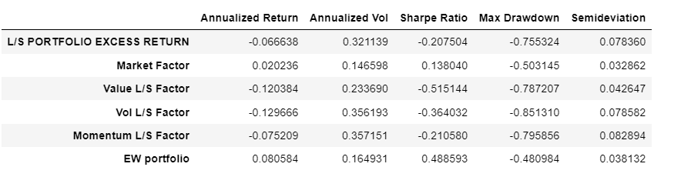
Factors/long-short strategy performance
As shown in the chart/table at the right hand slide, long-short investment strategy using highest combined factor scores for long portfolio and lowest combined factor scores for short portfolio has surprisingly significantly underperformed broader market and equal weighted portfolio with annualized return (-6.66%) and higher Sharpe ratio (-0.207).
The underperformance of long-short strategy was primarily driven by dismal performance of all factors constructed using short portfolios. This might be due to factors requiring a longer time period/low rebalancing frequency to give superior performance if constructed using short positions or presence of crash regime of 2008-09 in the dataset. We have checked performance with quarterly rebalancing frequency for long-short strategy, which is still underperforming the broader markets significantly.

Slide 8
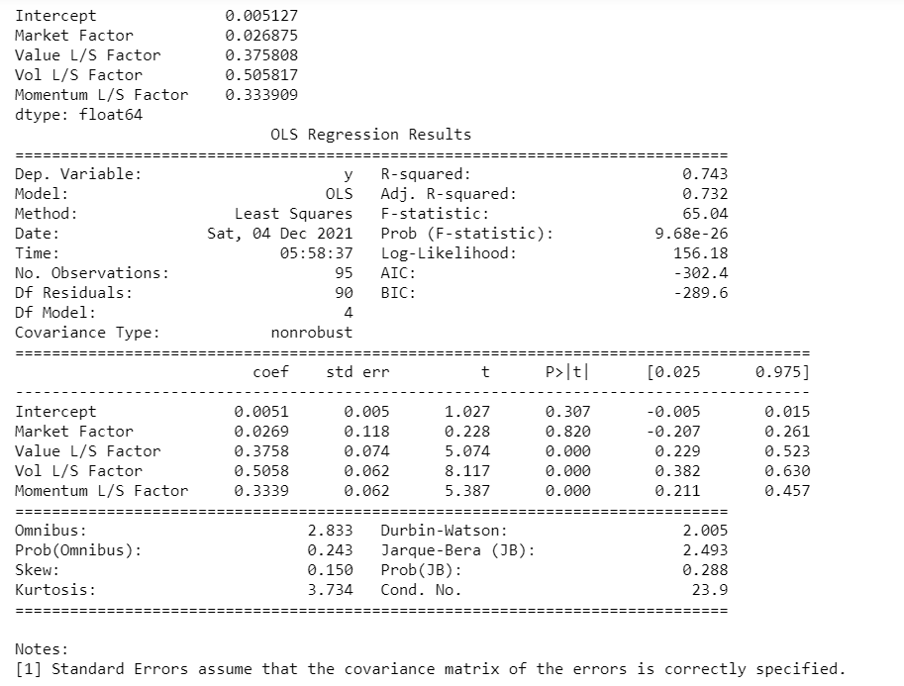
Long-Short strategy factor exposures
We use the OLS regression to compute the long-short investment strategy’s exposure on various factors. We have regressed long-only strategy returns with market risk premium, value, vol, and momentum factors calculated using long-short portfolio to determine the primary factors driving the strategy returns.
As shown in the table located at the right hand side, long-short strategy is primarily driven by vol factor with a slope coefficient of 0.5058 and t-stat of 8.117, followed by value factor with slope coefficient of 0.3758 and t-stat of 5.074.

Slide 9
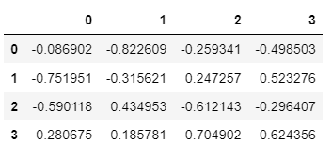
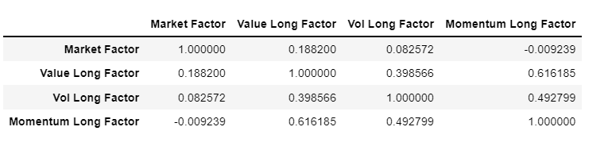
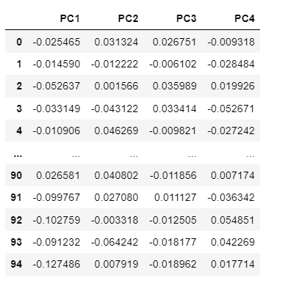
Correlation for long only factors/PCA factors
As we can see in the table located at the bottom right of this slide, all factors (value, vol, and momentum) have noticeable pairwise correlations among themselves (average correlation of +0.5) if constructed using long positions/portfolios. This eats away the potential benefit of diversification vs in the scenario where factors are completely independent of each other with very low pairwise correlations.
We have constructed PCA factor returns using principal component analysis technique for all four factors. The table at the bottom left of this slide shows the PCA factors returns. These factors have 0 pairwise correlations by definition. The middle table below shows the factor loadings/eigen vectors for these PCA factors.

Slide 10
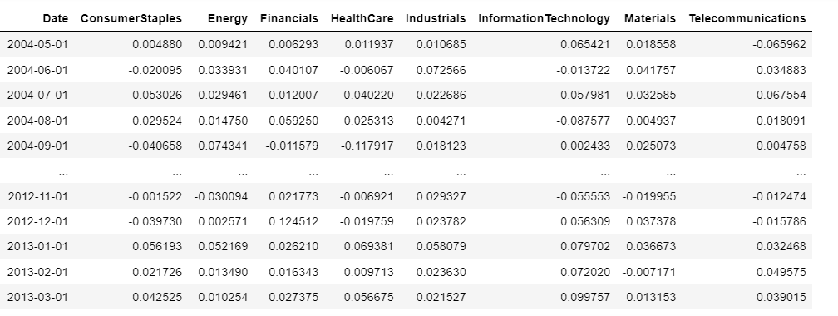
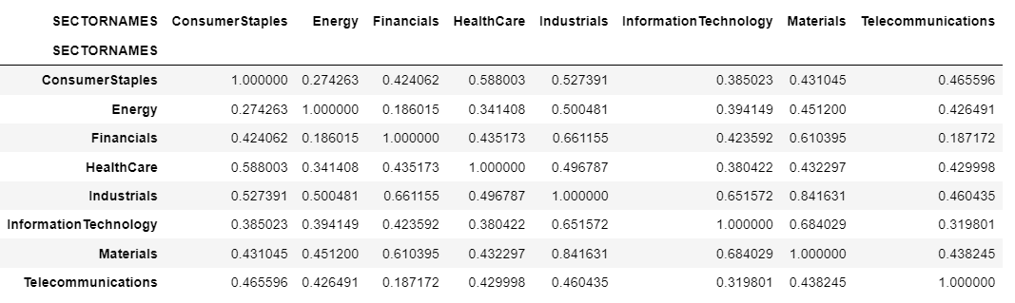
Sector factors
As an additional exercise, we looked at the monthly sector performance for 8 sectors in DJIA index and calculated the monthly returns for each sector factor.
The shown in the output at the bottom right of this slide, there is a significant pairwise correlation among sector returns for the period given in the dataset.

Slide 11
Conclusions
A multi-factor portfolio using long positions in stocks with most attractive factor scores outperforms the broader market and equally weighted portfolio with higher Sharpe ratio and lower drawdowns for the given dataset.
Factors show an average 0.5 pairwise correlation for the given time period which can eat away some diversification benefits. PCA based factors with no correlation among themselves could benefit the most using diversification.
Few other factors (Quality, Dividend yield, size) which have shown risk-adjusted outperformance vs broader market could be added to multi- factor portfolio to make its performance more robust and attractive.
Monthly rebalancing frequency can be reduced to (quarterly, biannually) to capture the performance of slow moving factors like value and quality.
Time period of dataset could be expanded to a sufficiently longer time scale so as to remove the effects of factors cyclicality from strategy performance and capture the full cycle risk premia of all factors for longer time horizon.

